Slide 1
Fundamentals of data mining 3

Slide 2
Statistical basis of machine learning
Review: maximum likelihood estimation (MLE)
getting parameters from data
Hoeffding’s inequality (HI)
how good are my parameter estimates?
Connection to machine learning
using a test set to estimate E_{out}(h)
VC bound on E_{out}(h)
is learning feasible?
Assignment #4

Slide 3
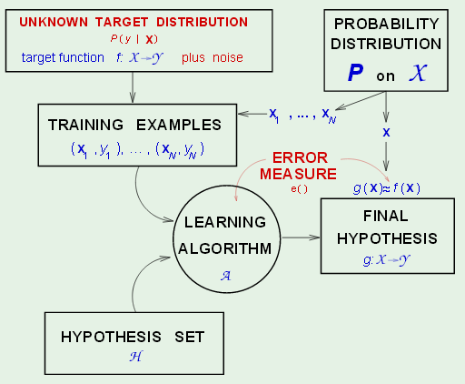
Learning diagram with noisy input
Input noise sets a lower bound on E_{in}(g) that should not be
passed regardless of hypothesis set and learning algorithm.
E_{in}(g) below this bound is called “over fitting”.

Slide 4
Review: Maximum Likelihood Estimation (MLE)
Estimate parameters θ of a probability distribution given a sample X drawn from that distribution
4

Slide 5
Form the likelihood function
Likelihood of θ given the sample X
l(θ|X) = p (X |θ) = ∏_{t} p(x^{t}|θ)
Log likelihood
L(θ|X) = log(l(θ|X)) = ∑_{t} log p(x^{t}|θ)
Maximum likelihood estimator (MLE)
θ* = argmax_{θ} L(θ|X)
the value of θ that maximizes L(θ|X)
5

Slide 6
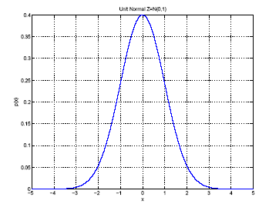
Example: Gaussian distribution
p(x) = N ( μ, σ²)
MLEs for μ and σ²:
μ
σ
Function of a single random
variable with a shape
characterized by 2 parameters
Lecture Notes for E Alpaydın 2010 Introduction to Machine Learning 2e © The MIT Press (V1.0)
6

Slide 7
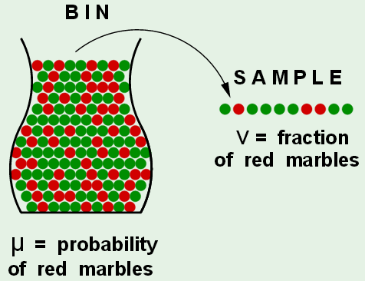
Pictorial representation of estimating a population mean
by a sample mean

Slide 8

Hoeffding’s inequality
H.I. says that the probability of |μ-ν| exceeding any specified ε
is < 2exp(-2ε²N), where N is the sample size.
Let δ = 2exp(-2ε²N) be the uncertainty that ε is an upper bound
Then 1-δ is the confidence that |μ-ν| does not exceed ε
The relationship δ = 2exp(-2ε²N) can be used in a variety of ways.
Given N and δ we can solve for ε to get an upper bound on |μ-ν|.
Given ε and δ we can solve for N, the sample size needed to get the
specified upper bound on |μ-ν| with the specified confidence.

Slide 9
Typical application of Hoeffding’s inequality in MLE
Suppose N=100 and we want 95% confidence, then
= 0.05 and ε = 0.14
We have 95% confidence that |(ν-μ)| < 0.14
How is Hoeffding’s inequality used in machine
learning?

Slide 10
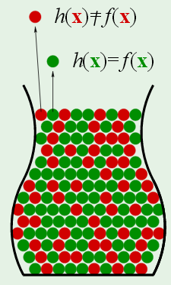
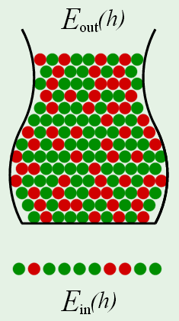
For a specific hypothesis h, E_{out}(h) is analogous to
the probability of red marbles. E_{in}(h) = E_{test}(h) is
analogous to a sample mean.

Slide 11
In this analogy, the sample is not the training set.
The sample is data not used in selecting the optimum hypothesis but designed to give an approximation to E_{out}(h_{opt})

Slide 12
For a specific hypothesis h, Hoeffding’s inequality
does not applies if the sample on which E_{in}(h) is
evaluated was used in the selection of h.
Usually, h is optimum member of an hypothesis
set chosen by application of training data and
E_{in}(h) is evaluated on a test set.
Recall, δ = 2exp(-2ε²N) is the uncertainty that ε is
an upper bound on |E_{test} - E_{out}|

Slide 13
As with any estimate of population mean
Given a test-set size N and confidence level 1-δ
then |E_{test} - E_{out}|< ε(δ,N) = sqrt(ln(2/δ)/2N),
obtained by solving δ = 2exp(-2ε²N) for ε.
Sponsor requires 98% confidence that ε(δ,N)=0.1.
How large does N have to be to achieve this?
Solve sqrt(ln(2/δ)/2N) = 0.1 for N, given δ=0.02

Slide 14
Test set dilemma
H.I. only applies to unbiased estimates of mean
Test set cannot be training data used to select
optimum hypothesis
Test set must be large to get useful confidence
from Hoeffding’s inequality.
Appears that useful test of data mining results
requires sacrifice of a large part of training data.

Slide 15
Leave-one-out: solution to test set dilemma
Given a well-chosen hypothesis set (that may have involved the use of a validation set to get the best complexity), let g_{opt} be the hypothesis that minimizes the in-sample error of the full training set.
Let g_{-1k} be the hypothesis that minimizes the in-sample error of the full training set minus the k^{th} datum.
Let e_{-1k} be the error in predicting the k^{th} datum by hypothesis g_{-1k}
E₋₁ = < e_{-1k} >, the average of errors predicting the datum left out, is a good approximation to E_{test}(g_{opt}) that can be used with Hoeffding’s inequality.

Slide 16
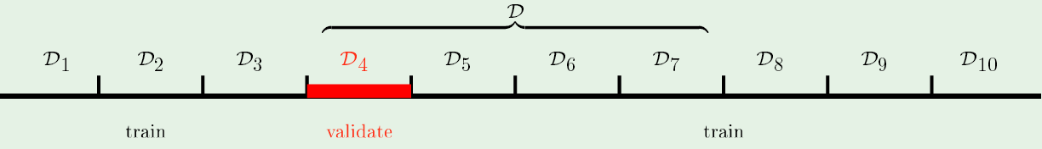
K-fold cross validation
Leave-one-out gives estimate of E_{test} based on all data
g_{-1k} should be close to g_{opt} for any one datum left out
Lots of computation if the dataset is large
10-fold cross validation is a compromise
Not as much computation
But g₋₁₀ not as close to g_{opt} as g_{-1k}
Diagram illustrates calculation of g₋₁₀ when the 4th
one tenth of the training data is left out

Slide 17
Use all training samples for best model
It is not necessary or desirable to sacrifice examples
in the data set for either model selection (validation set)
or assessing quality (test set)

Slide 18
VC bond on E_{out}(h)
We know how to place a bound on |E_{test} - E_{in}| because Hoegffdings inequality applies.
But we are only guessing that E_{test} ~ E_{out}
Can we bound |E_{out} - E_{in}| without a test set?

Slide 19
Review: For a specific hypothesis h, E_{out}(h) is
analogous to the probability of red marbles.
E_{in}(h) is analogous to a sample mean.

Slide 20
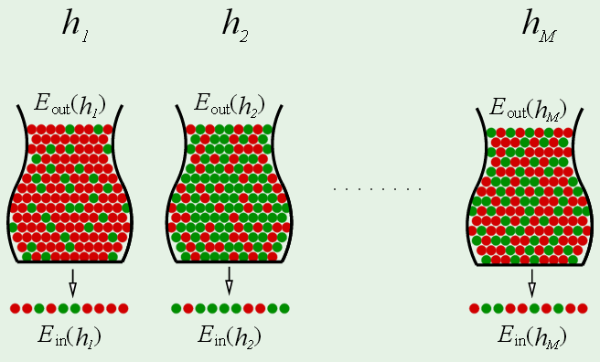
In machine learning we deal with multiple hypotheses. Each h can
have a different distribution of correct and incorrect examples in
the population and a different in-sample error

Slide 21
Each test of an hypothesis is an independent event
One of these events has the smallest E_{in}(h) and determines the
optimum hypothesis g

Slide 22
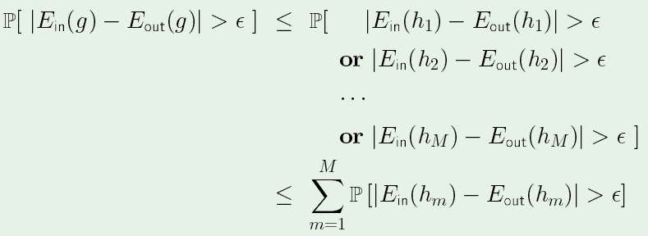
Modifying Hoeffding inequality for finite hypothesis set
Since g is the optimum hypothesis, P|E_{in}(g) – E_{out}(g)|> ε
is likely to be smaller than P|E_{in}(h) – E_{out}(h)|> ε for most
members of the hypothesis set and certainly smaller than
their sum

Slide 23
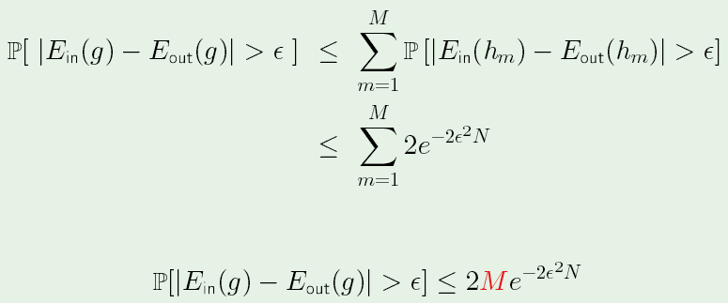
Appling Hoeffding inequality to each term in the sum
gives “union” bound
Union bound approximation shows “feasibility of learning”
for finite hypothesis sets. For any (ε,δ) combination,
P[|E_{in}(g) – E_{out}(g)|> ε] < δ by sufficiently large N.

Slide 24
Union bound is not practical
This simple result has no practical value because (1) it is
a very conservative bound and (2) most hypothesis sets
used in machine learning are infinite.

Slide 25
Infinite hypothesis sets operate on finite datasets
Let h be a member of an infinite hypothesis set used to train a
dichotomizer.
For ever example in the training set (size N), h will predict +1 or -1
The collection of these predictions is a dichotomy (i.e division of the
training set into 2 classes)
Define |H( x₁, x₂, … x_{N})| as the number of dichotomies that members
of the hypothesis set H can produce for a training set of size N
Even though |H| is infinite |H( x₁, x₂, … x_{N})| < 2^{N}, the total number
of distinct dichotomies that can be produced by N prediction of +1
Hence there must be redundancy in predictions by members of H

Slide 26
Replace the union bound by a bound on the
“growth function”
m_{H}(N) = max(|H( x₁, x₂, … x_{N})|) < 2^{N}
Growth function of hypothesis set H applied to
training sets of size N to learn a dichotomizers
is the maximum number of dichotomies that
can be generated by H on any set of N points
in the attribute space.

Slide 27
Growth function m_{H}(N) is closely related the VC dimension of H defined by:
“If there exists h ∈ H consistent for all 2^{N} ways that N points can be labeled with {+1,-1} then
d_{VC}(H ) = N.” We say “H can shatter N points”
In terms of m_{H}(N), d_{vc}(H) can be defined as the largest value of N for which m_{H}(N) = 2^{N}
Lecture Notes for E Alpaydın 2010 Introduction to Machine Learning 2e © The MIT Press (V1.0)
27

Slide 28
Break points
If no dataset of size k can be shattered by H, then k is a “break point” of H
If k is a break point of H, then m_{H}(k) < 2^{k}
Since d_{vc}(H) can be defined as the largest value of N for which m_{H}(N) = 2^{N}, k= d_{vc}(H)+1 is a break point

Slide 29
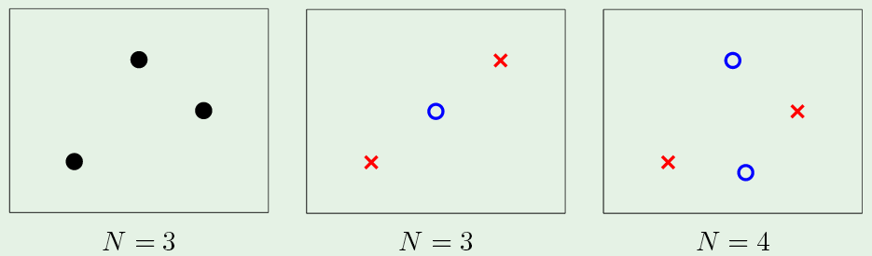
H = linear dichotomizer in 2D
m_{H}(3) = 8: no break point. Even though 3 points in line
cannot be shattered, m_{H}(3) is the maximum number of
dichotomies for any set of points. d_{vc}(H)=3
Every set of 4 points has 2 labeling that cannot be
shattered by a 2D dichotomier. k=4 is break point = d_{vc}(H)+1
For dD dichotomizer, d_{vc}(H) = d+1.

Slide 30
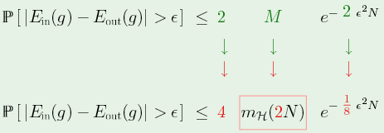
How does a finite VC dimension of an infinite hypothesis
set H ensure the feasibility of learning with H?
1) Replace the union bound (valid for finite H-sets) with
growth function (valid of infinite H-sets)

Slide 31
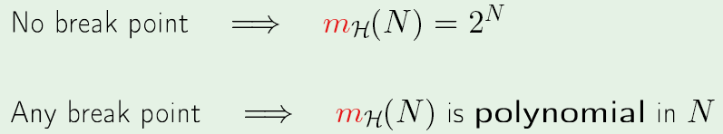
How does a finite VC dimension of an infinite hypothesis
set H ensure the feasibility of learning with H?
1) Replace the union bound (valid for finite H-sets) with
growth function (valid of infinite H-sets).
2) If H-set applied to a training set of size N has any
break point, then growth function is a polynomial in N

Slide 32
How does a finite VC dimension of an infinite hypothesis
set H ensure the feasibility of learning with H?
1) Replace the union bound (valid for finite H-sets) with
growth function (valid of infinite H-sets).
2) If H-set applied to a training set of size N has any
break point, then growth function is a polynomial in N
3) k= d_{vc}(H)+1 is a break point.

Slide 33
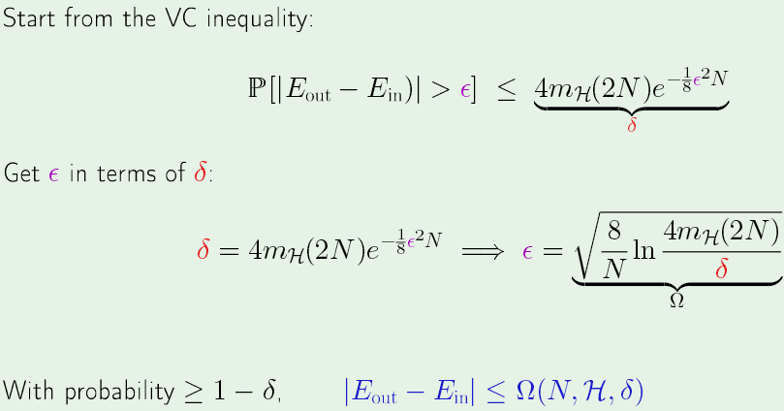
Since polynomials are exponentially dominated,
δ can be make arbitrarily small, regardless of the size of ε, by increasing the size of N

Slide 34
Feasible, yes. Practical, maybe not
Suppose we want ε < 0.1 with 90% confidence (i.e. δ = 0.1)
We require
using
We get
Assignment 2: Use a non-linear root-finding code to solve
this implicit relationship for N with d_{VC} = 3 and 6.
Hint:

Slide 35
Assignment 4, due 9-29-16
Suppose we want ε < 0.1 with 90% confidence (i.e. δ = 0.1)
VC bound says
If
then
Use a non-linear root-finding code to solve this implicit
relationship for N with d_{VC} = 3 and 6. Hint

Slide 36
|E_{out} – E_{in}| < Ω(N,H,δ) is called the “VC bound”
Dependence on H is through the VC dimension
δ can be make arbitrarily small, regardless of the size of ε, by increasing the size of N, but required size increases with increasing VC dimension.

